Slide 1


The Power of Work-Based Learning
Presented to you by:
Heather Thomas
September 2024

Slide 2


Overview of the Session
1
2
3
4
5
Understanding Work-Based Learning (WBL)
Benefits of WBL for Students and Educators
Engaging Employers Effectively
Key Questions to Consider
Tools and Resources

Slide 3

Understanding Work-Based Learning (WBL)

Slide 4

Work-Based Learning
On a scale of 1-5, how would you rate your knowledge of Work-Based Learning?
On a scale of 1-5, how well do your CTE programs align with Work-Based Learning?

Slide 5
Definition of Work-Based Learning
Work-Based Learning is a continuum of intentional activities and experiences designed to expand the boundaries of the classroom and prepare students for future career opportunities. Activities and experiences begin as early as pre-kindergarten and continue through postsecondary education.
Work-Based Learning provides opportunities for students to:
1
2
3
4
Apply academic and technical knowledge and skills learned in the classroom in a realistic setting
Engage with business and industry professionals
Explore and experience potential career options
Develop and practice essential employability skills

Slide 6

Benefits of WBL for Students and Educators

Slide 7
Benefits of Work-Based Learning
For Students
For Educators
Enhances Career Readiness
Provides Hands-On Experience
Builds Professional Networks
Increases Engagement and Motivation
Strengthens Curriculum Relevance
Fosters Industry Relationships
Bridges the Gap Between Theory and Practice

Slide 8
Work-Based Learning
What are your Work-Based Learning challenges?

Slide 9
Work-Based Learning
How many programs of study does your district have?
How many of those have an industry partner?

Slide 10
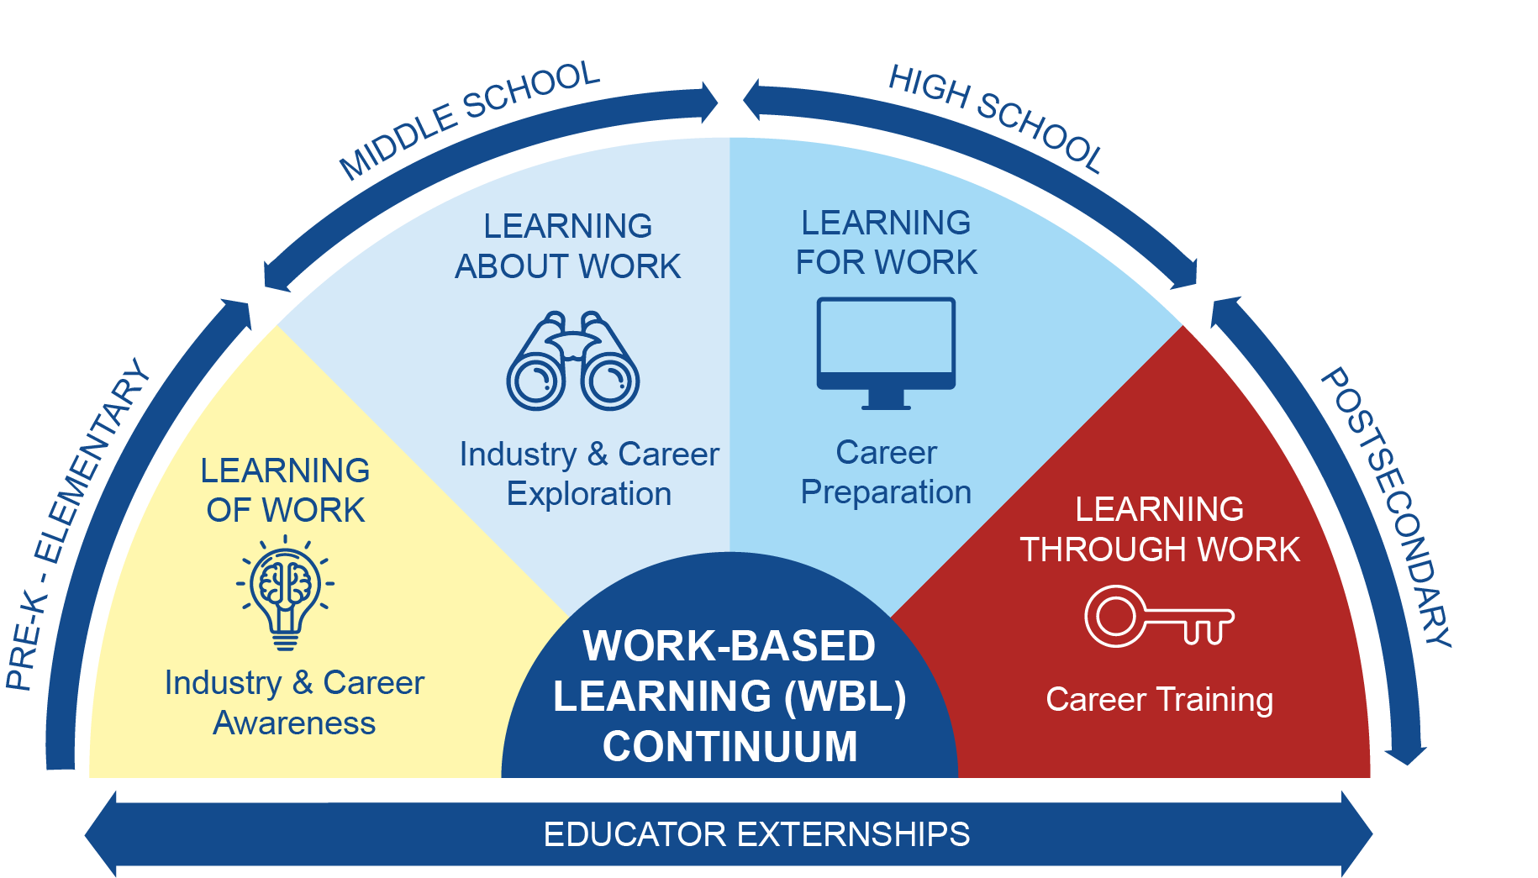

Slide 11

Pre-K - Elementary
Activities
*Career Day Events
Career Play Centers
*Guest Speakers
Curriculum (Resource)
*indicates where employers are needed

Slide 12
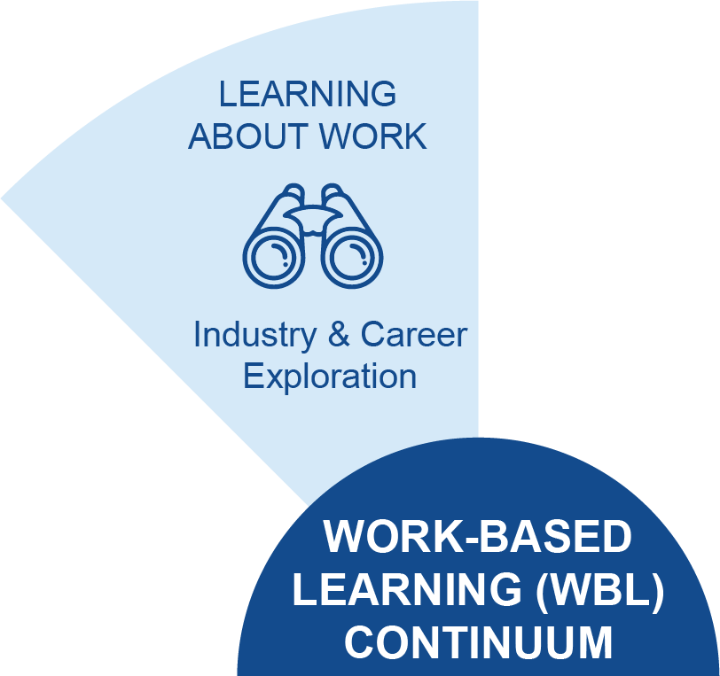
Middle School
Activities
VR Headsets
Aptitude Tests
Guided Research Projects
Interest Surveys
High School Tours
*Mentorship Programs
Project-Based Learning
Strengths Finders
*Career Days
*Interviewing Professionals
*Field Trips/Worksite Tours
*indicates where employers are needed

Slide 13
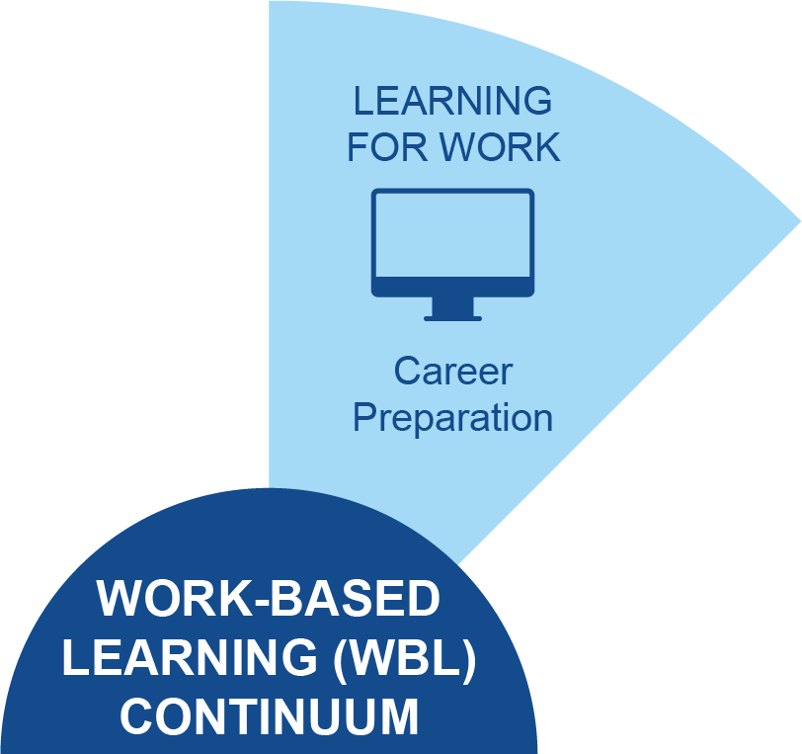
High School
Activities
Credential or License Attainment
Mock Job Interviews
Resume and Cover Letter Prep
Interest Surveys
Simulated Workplace Programs
Career Preparation Class
*Practicum (sometimes inhouse)
*Internship
*Pre-Apprenticeships
*Youth Apprenticeships
*Job Shadowing
Career and Technical Student
Organizations Competitions (CTSO)
*indicates where employers are needed

Slide 14
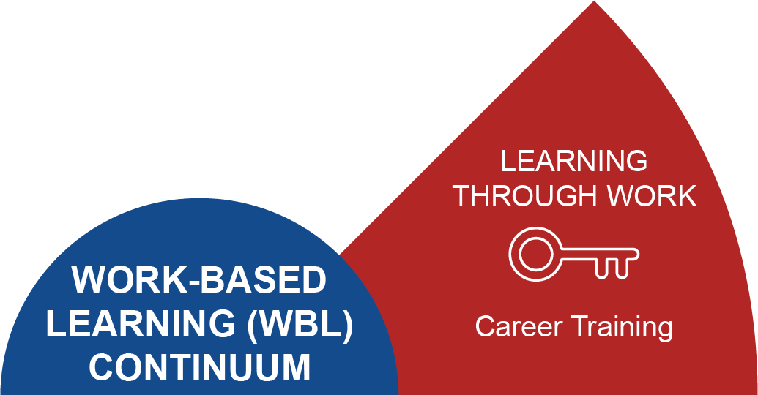
Postsecondary
Activities
Credential or License Attainment
Associates Degree and/or
Bachelors Degree
Skill Retraining
*Registered Apprenticeships
*Internships
*indicates where employers are needed

Slide 15

Engaging Employers Effectively

Slide 16
Ways in which employers can get involved
Guest Speaking
Facility/Worksite Tours
Job Shadowing
Mentorships
Mock Interviews
Career Day Participant
Scholarships
Internships
Industry-Based Certifications
Serve on an Advisory Board
Donate Equipment/Learning Space Setup
Apprenticeships
Curriculum Collaboration
Offer Volunteer Opps

Slide 17

Key Questions to Consider

Slide 18
Questions to Consider
Asking Employers
Self-Reflection
What skills are most important for your industry?
How can our students add value to your organization?
What challenges do you face in finding qualified candidates, and how can we help address them?
How can I integrate WBL into my curriculum?
What support do I need to effectively engage employers?
How can I ensure that all students have access to WBL opportunities?

Slide 19
Next Steps
CTE Advisory Night

Slide 20
Q & A
Share specific strategies or experiences
Challenges

Slide 21

Tools and
Resources

Slide 22
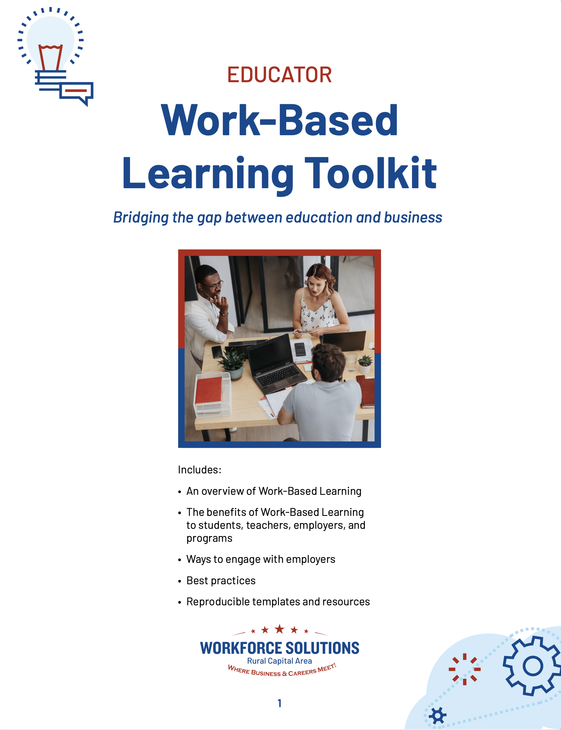
Teacher Handbook for Work-Based Learning
https://workforcesolutionsrca.com/for-training/work-based-learning

Slide 23

Let’s Stay Connected
Heather Thomas
Regional Convener
Heather.Thomas@ruralcapital.net

